Slide 1
Evaluation Lessons
EARLY GRADE READING SYNTHESIS AND LESSONS
Presentation by: Nompumelelo Nyathi-Mohohlwane
Organisation DBE
Date: 3 July 2025

Slide 3
PRESENTATION TITLE
EARLY GRADE READING SYNTHESIS AND LESSONS
Early lessons
RCTs - when and how to randomise
Mixed Methods - what they contribute
Data collection lessons
Designing assessments

Slide 4
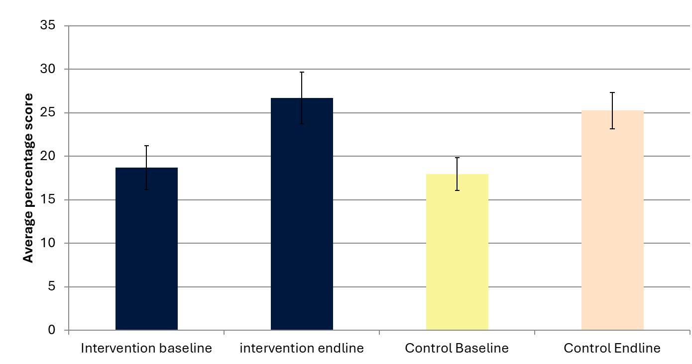
METHODS MATTER?
EARLY GRADE READING SYNTHESIS AND LESSONS
RCUP Lessons - Value of a counterfactual
Notes:
Prior to 2014- descriptive work - limited experiments, GPLMS move towards causation

Slide 5
METHODS MATTER?
EARLY GRADE READING SYNTHESIS AND LESSONS
GPLMS & RCUP Lessons
RCUP 2014 RCT - value of a counterfactual
Robust methodology highlighted that not all well-meaning or plausible sounding interventions will have impact on learning outcomes
Invest in robust impact evaluation methods to draw accurate conclusions about programme effectiveness (#methodsmatter),
Small well designed studies as catalysts for informing policy
Stakeholder role to learn from zero impact results - donors, implementers, provinces/government
Notes:
Prior to 2014- descriptive work - limited experiments, GPLMS move towards causation

Slide 6
METHODS MATTER
EARLY GRADE READING SYNTHESIS AND LESSONS
When to Randomise
Run an RCT if the evidence is needed to make key policy decisions
RCT remains the best way to identify the causal effect of an intervention
Randomisation is easier than you think
Before you intervene !
Feasibility and design of evaluation methods should be informed upfront
When implementation will be staggered or not universal

Slide 7
METHODS MATTER
EARLY GRADE READING SYNTHESIS AND LESSONS
How to Randomise
Identify your sample size early
40 school per group
A sampling frame close to the target population
External validity
Threshold functionality
Sample Size: detecting significant results if the expected effect size is as large as expected
No 5% sample rule of thumb; 40 schools is better
Easier to increase your control group often
Availability of online resources on sampling
Notes:
Evaluations are costly, so there is a trade-off between increasing the sample size and managing costs. A sample that is too small may fail to detect a significant effect, making the results inconclusive.
Rule of thumb. Generally, in South Africa, for education interventions, 40
schools is the lower bound of what is reasonable to pick up effect sizes on such a
2-year intervention.

Slide 8
METHODS MATTER
EARLY GRADE READING SYNTHESIS AND LESSONS
Mixed Methods
Mixed-methods approach, blending randomised experiments with more detailed classroom observations and case studies.
Result: a robust and expanding research agenda - investments in assessment
instruments and practice, and monitoring and evaluation
Theory of Change
Qualitative Research
Tracking post-intervention
Ongoing Monitoring & Evaluation

Slide 9
METHODS MATTER?
EARLY GRADE READING SYNTHESIS AND LESSONS
Implement Quality Assurance
Standardised Data Collection Procedures. Ensure all enumerators follow
clear, written protocols to minimise inconsistencies.
Training and Pilot Testing. Train fieldworkers thoroughly (at least 5 days).
Include simulation in the training to identify and resolve potential issues.
Invest in credible data collection systems - credibility and cost implications
Where possible use tablets for digital data entry as this allows for real-time validation of data coming in during data collection.
Spot checks in the field.
Cross-Validation and Error Checking. Implement built-in logic checks into the process

Slide 10
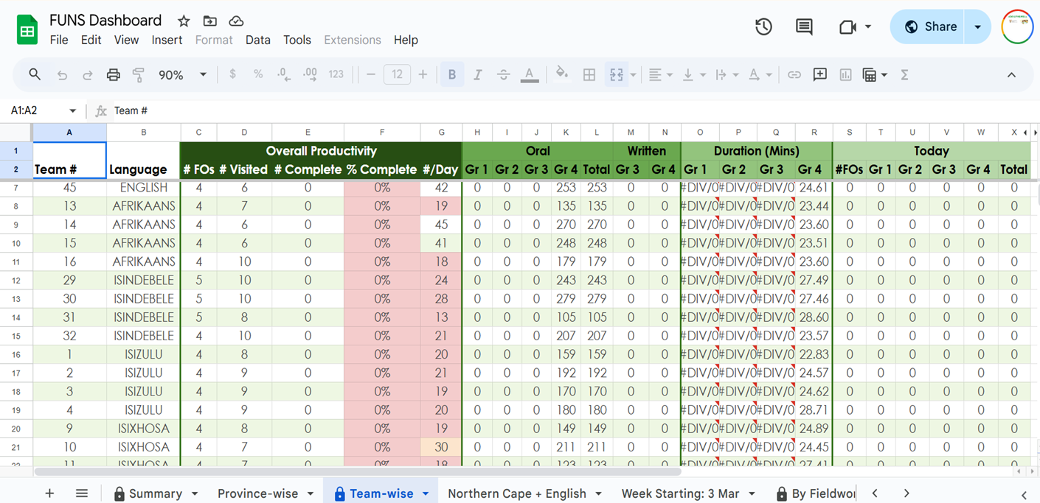
METHODS MATTER?
EARLY GRADE READING SYNTHESIS AND LESSONS
Implement Quality Assurance

Slide 11
METHODS MATTER
EARLY GRADE READING SYNTHESIS AND LESSONS
Assessment Lessons
Utilise existing, relevant, validated test instruments and adapt where necessary
Ensure that the instrument is fit-for-purpose
Set the right standard of difficulty
Pilot and adjust the level of the assessment
Develop language specific benchmarks

Slide 12
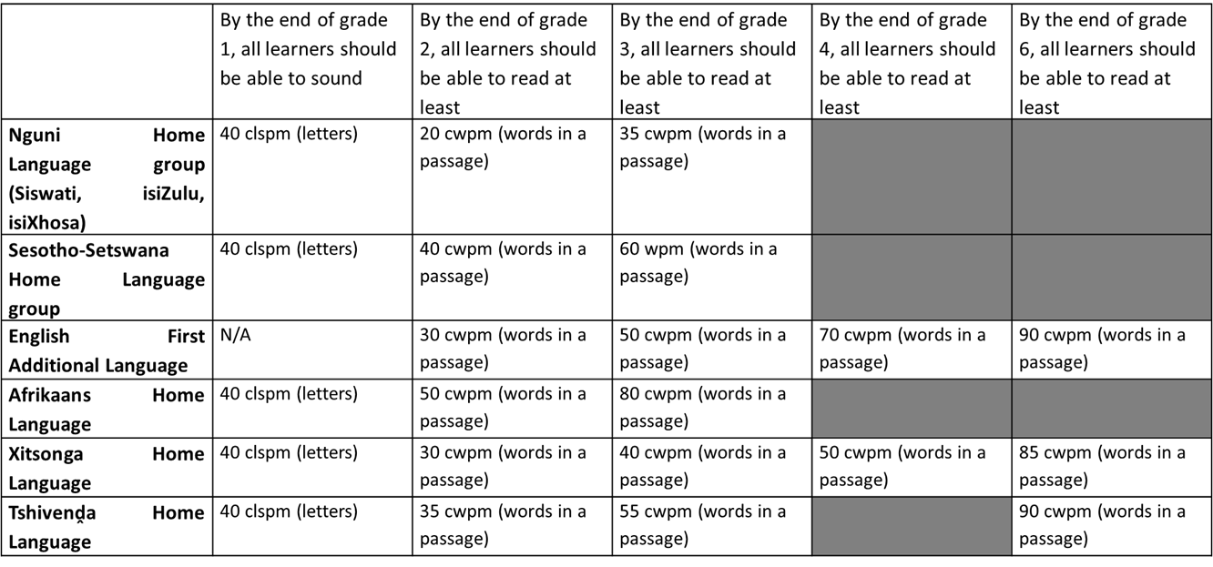
METHODS MATTER
EARLY GRADE READING SYNTHESIS AND LESSONS
Assessment Lessons

Slide 13
Thank you

